Slide 1
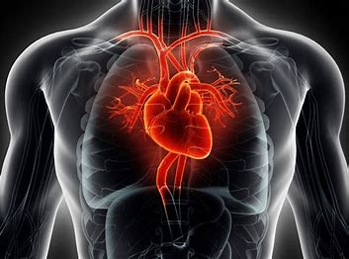
Heart Disease (Projrct By: Arti Yadav)

Slide 2
INTRODUCTION
The human heart beats about 2.5 billion times over an average lifetime, pushing millions of gallons of blood throughout the body. This steady blood flow carries oxygen, hormones, and other compounds. It also whisks away the waste products of metabolism.
Heart disease and cardiovascular disease are two of the most significant heart health issues. They are often used interchangeably, but they are not the same.
Heart disease refers to diseases of the heart, such as coronary artery disease, heart failure, heart valve abnormalities, and abnormal heart rhythms.

Slide 3
Variable Discription
Attributes | Discription
Age | Age of a patient [years]
Sex | Gender of the patient [M: 1, F: 0]
CP | chest pain type [3: Typical Angina, 2: Atypical Angina, 1: Non-Anginal Pain, 0: Asymptomatic]
trestbps | Blood pressure in Hg (Normal blood pressure - 120/80 mmHg)
Chol | Serum cholestrol level in blood (Normal cholesterol level below for adults 200mg/dL)
fbs | Fasting Blood Sugar (0=Normal less than 100mg/dL for non diabetes ,1=for diabetes 100-125mg/dL)
restecg | resting electrocardiogram results [0: Normal, 1: having ST-T wave abnormality (T wave inversions and/or ST elevation or depression of > 0.05 mV), 2: showing probable or definite left ventricular hypertrophy by Estes' criteria]
thalach | maximum heart rate achieved [Numeric value between 71 and 202]
exang | exercise-induced angina [1: Yes, 0: No]
oldpeak | oldpeak = ST depression induced by exercise relative to rest. [Numeric value measured in depression]
ST_Slope | the slope of the peak exercise ST segment [2: upsloping, 1: flat, 0: downsloping]
CA | Number of Major Vessels 0-4 (colored by flourosopy)
Thal | 0:No Defect,1:Reversible Defect,2:Non-reversible Defect,3:Fixed defect
Target (Heart Disease) | output class [1: heart disease, 0: Normal]

Slide 4
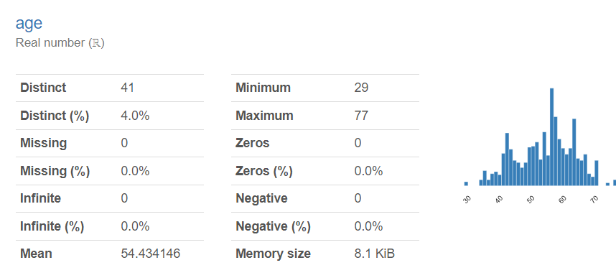
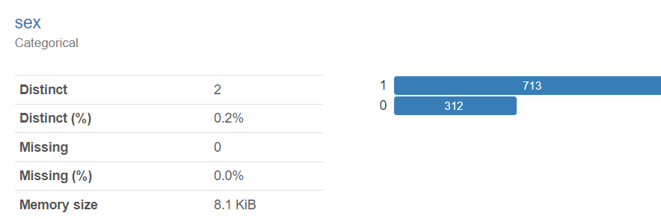
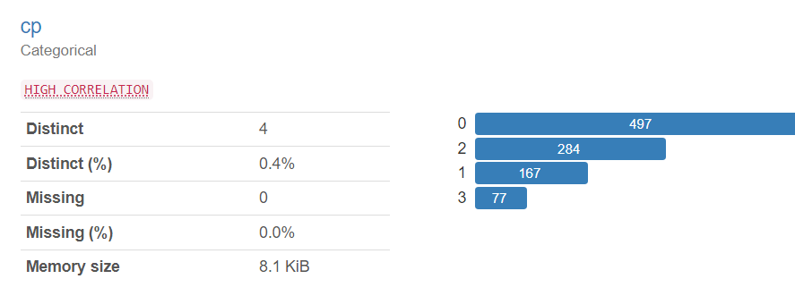
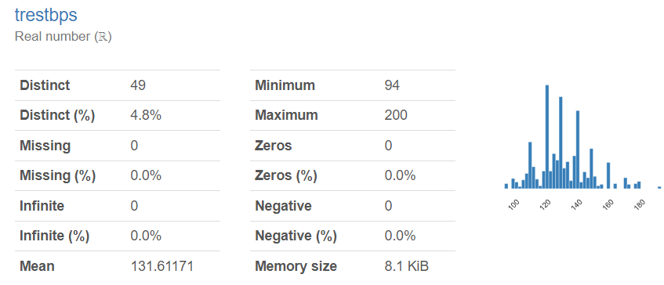
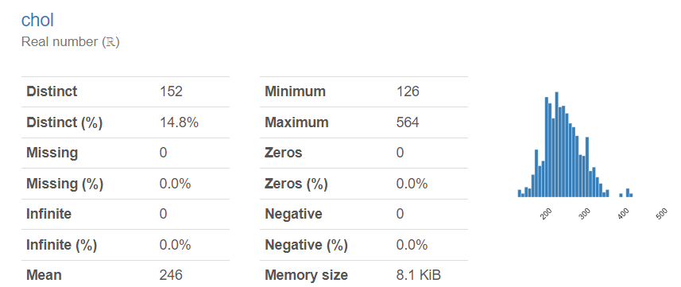
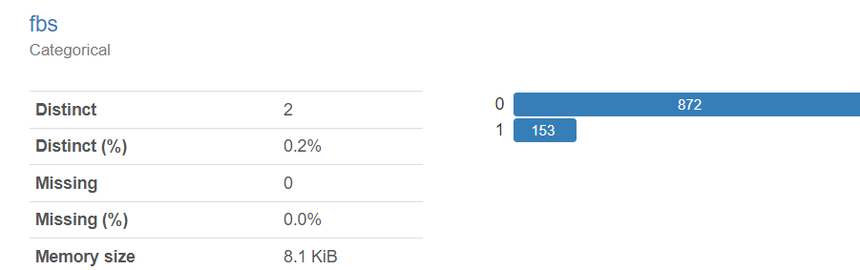
Variables Summary:

Slide 5
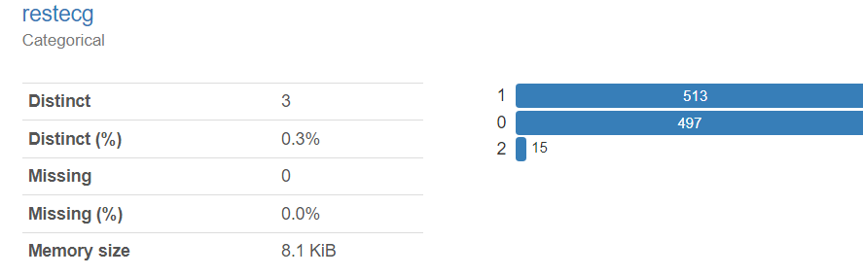
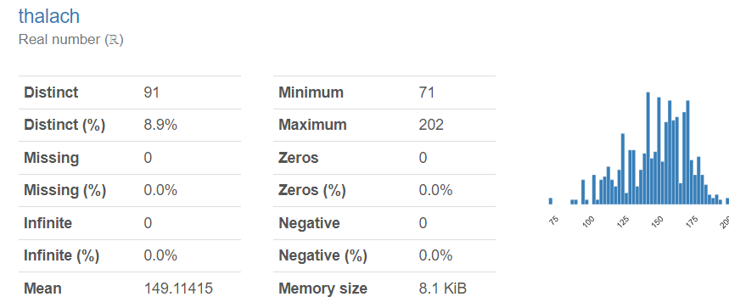
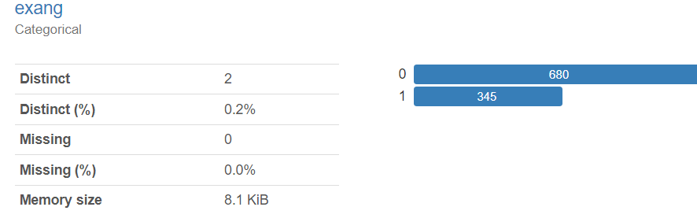
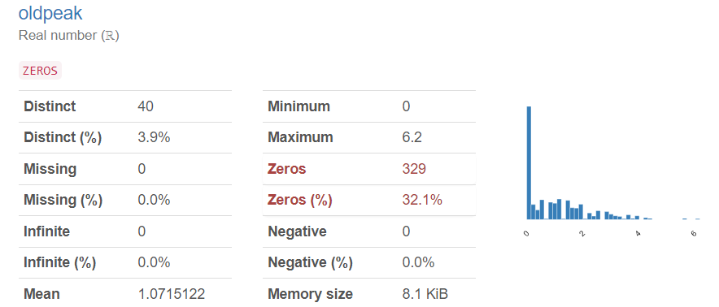
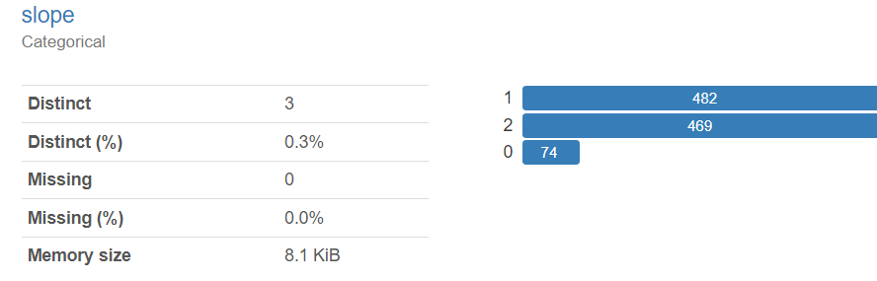
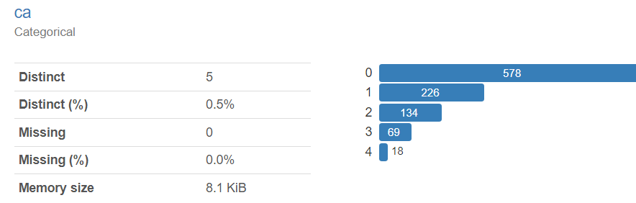
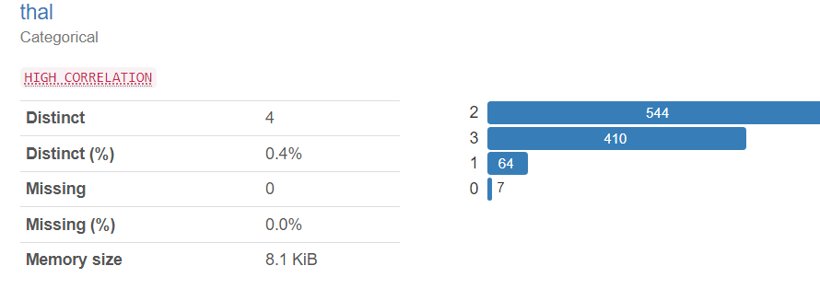
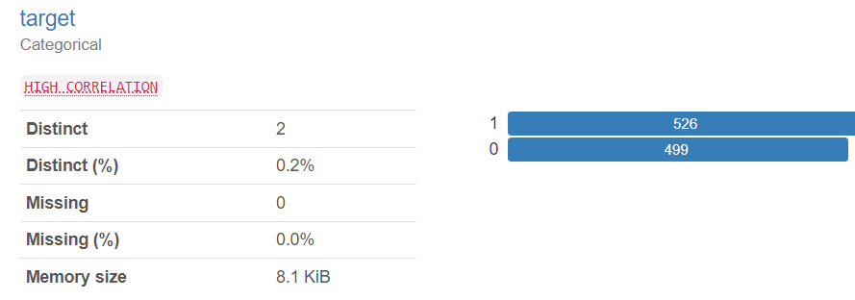

Slide 6
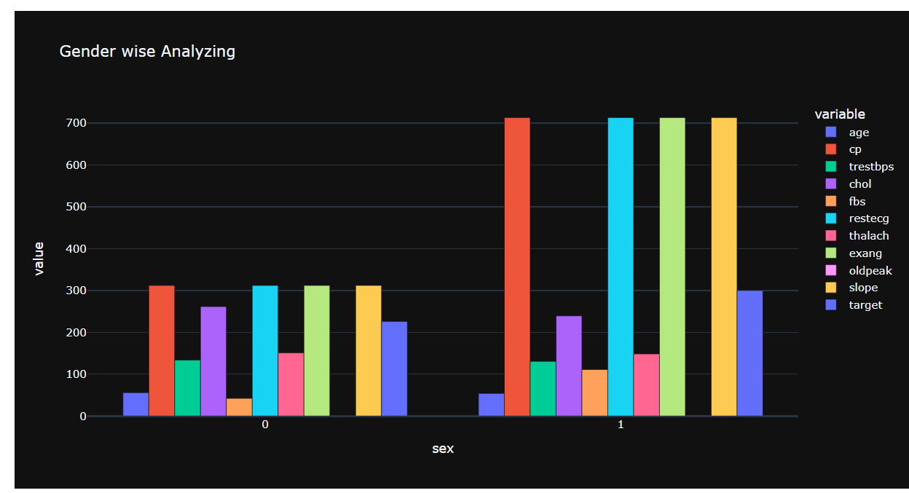
Gender Wise Analysis:
From above table & plot we can observe that:
Average age of males & females are almost similar.
cp(chest pain type) counts in males are higher tan females.
Average resting blood pressure of males & females are almost similar.
Average cholestrol levels in females are higher than males.
the sum & count of fasting blood sugar and ecg are higher iin males than females.
thalach(max heart Rate) is slightly higher in females as compare to males.
ExerciseAngina & slope counts are less in females than males.
males are mostly affected by heart disease followed by females.

Slide 7
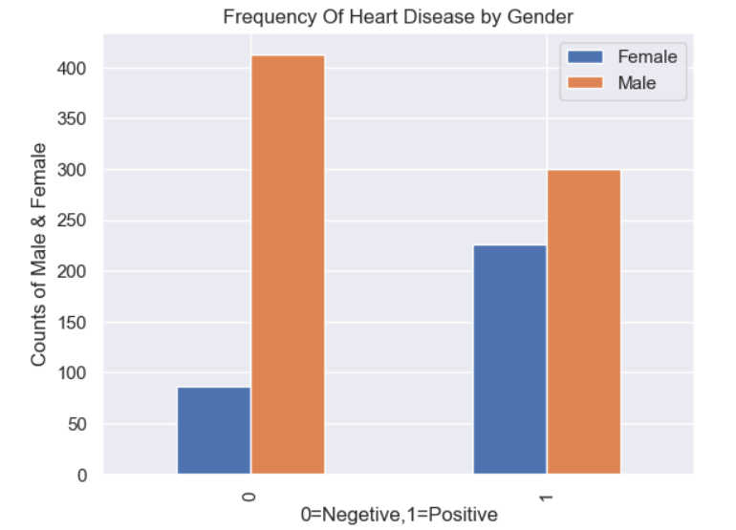
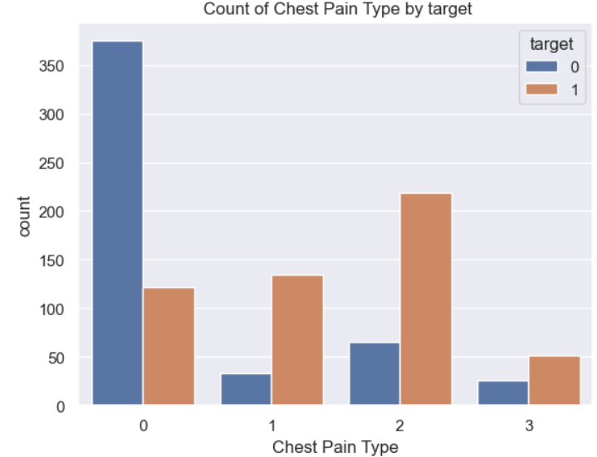
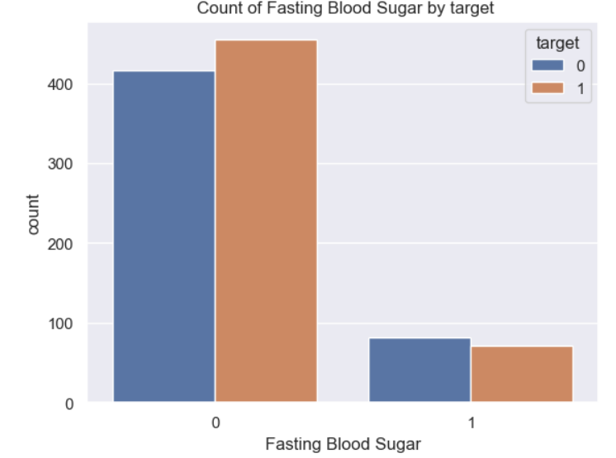
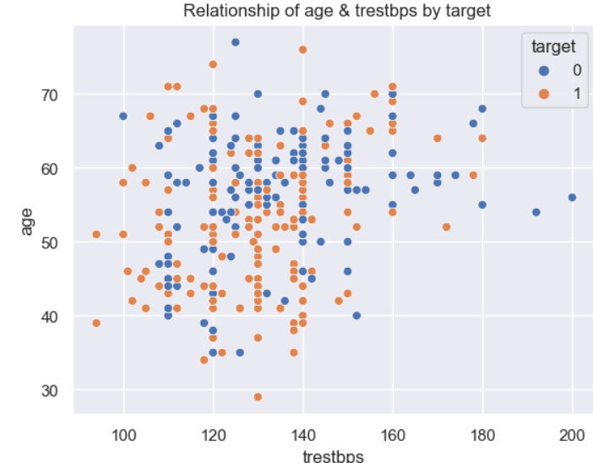
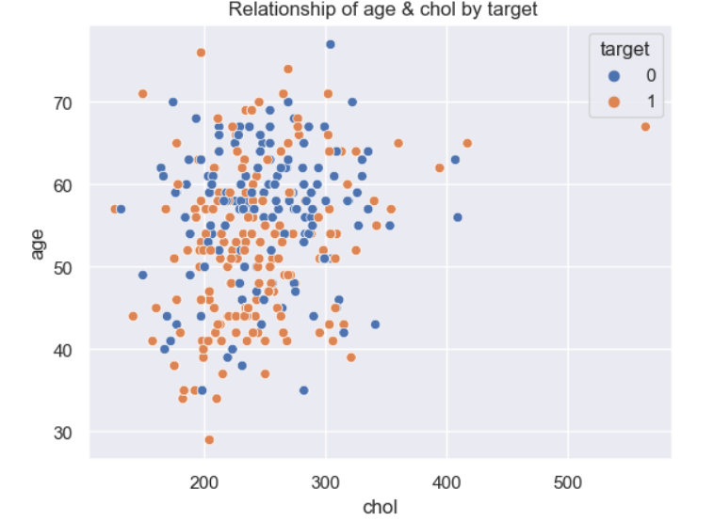
More Insights Of Variables:

Slide 8
KEY POINTS :
According to the data we can conclude that males are mostly affected by heart disease rather than females.
Patient with chest pain type 2 (Atypical Angina) follwed by chest pain type 1(Non-Anginal Pain)are more likely to get affected by heart disease.
Patient having Fasting Blood Sugar more than normal range(100-125mg/dL) are having more chances to get a heart disease.
Blood Pressure at resting stage age wise seems to be increasing.
Cholestrol level in elder patients seems to be higher as compare to younger pateints.

Slide 9

“Listen to your heart, it knows the way to a healthier you.” Thank You….. "Don't wait until it's too late to start taking care of your heart."
www.linkedin.com/in/arti-yadav-428b11229
https://drive.google.com/file/d/1gVYRxEFFhIBfih1kaBj4BmGK-dtSBYAC/view?usp=drive_link

